Slide 1


Nano Computing Research Group Srinivas Rahul Advisor: Dr. Mostafizur Rahman
Hardware Dependent Performance/Accuracy Benchmarks of Deep Neural Networks

Slide 2
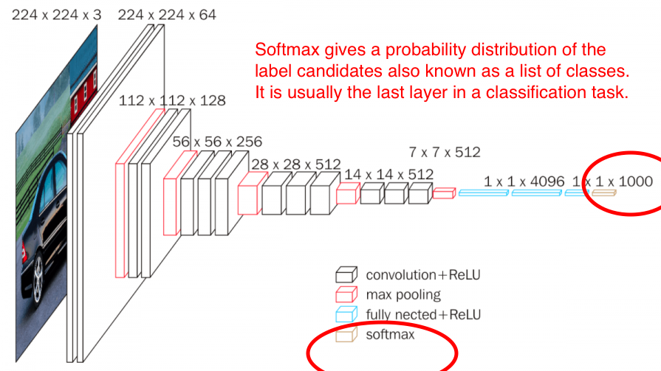
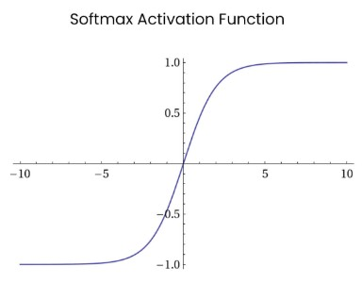
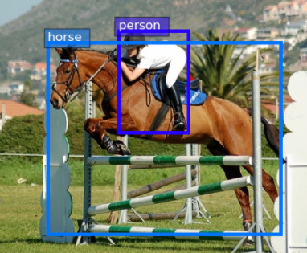
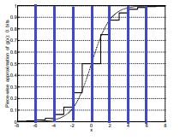
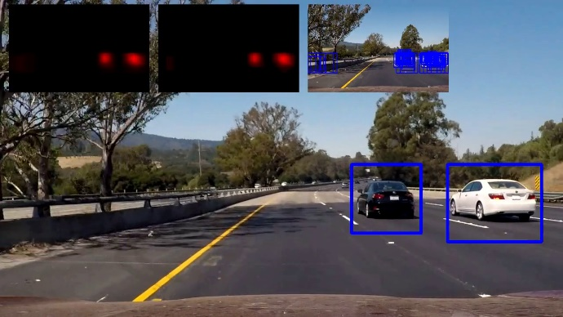
My Project
Softmax is a common building block for many DNN-based computer vision applications.

Slide 3
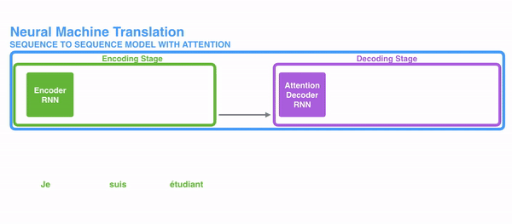
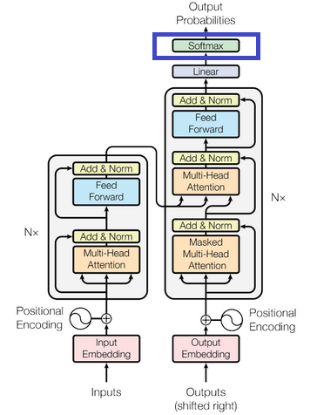

Transformers

